Slide 1
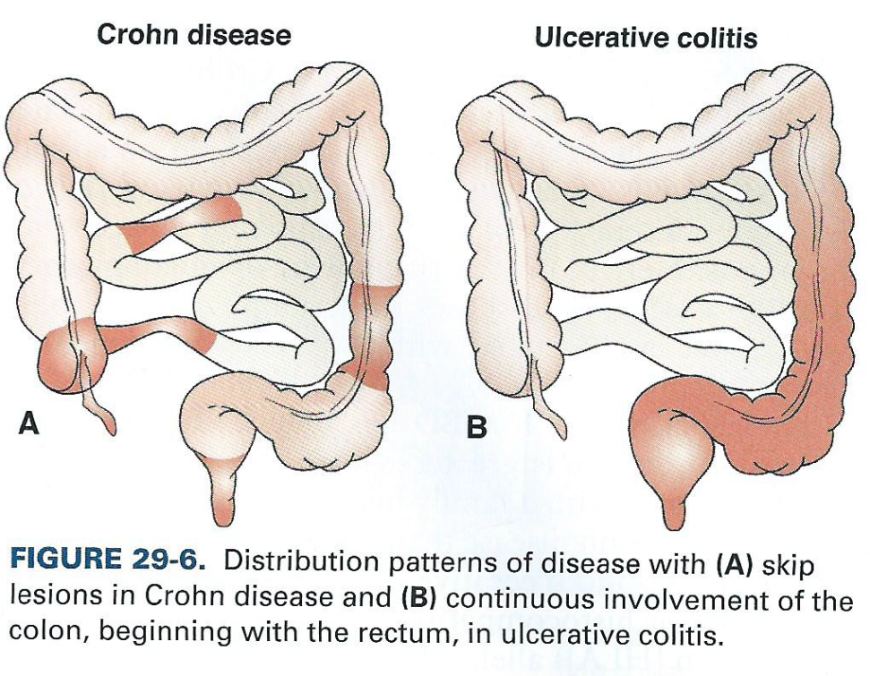
Inflammatory Bowel Disease: inflammatory conditions of the colon and small intestine.
The main forms of IBD are Crohn's disease and ulcerative colitis (UC).
Inflammatory bowel diseases are considered autoimmune diseases.
IBD complications:
Malabsorption leading to nutritional deficiencies
Weight loss 40-80%
Fe+ deficiency anemia 25-50%
B12 deficiency 20-37%
Osteomalacia 36%
Hypoalbuminemia 25-76%
Increase in Colon Cancer, especially Colitis.
Monitor: Colonoscopy q 6-12months

Slide 2
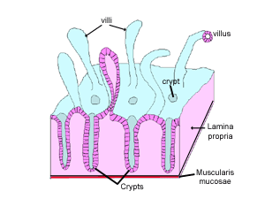
Inflammatory Bowel Disease: UC vs Crohns
 | Ulcerative Colitis (UC) | Crohn’s Disease
Location | Colon and Rectum | Any Part of GI: Pancolitis = entire colon (panorama) Proctitis = rectum only
Lesions | Shallow layer Continuous Lesions Crypts of lieberkuhn | All layers Discontinuous Lesions (patchy)
Pathophysiology (Next slide) | Lesions in the form of ulcers | Inflamed Narrowing Fistulizing abnormal connections (usually bowel to skin)
S/S | More Mild: Excessive bowel movements bloody stools | More Severe: obstruction chronic diarrhea weight loss
Relapse | 70% relapse within 1st year | 20% relapse every year
Notes:
4 Layers from inner to outer: Mucosa, submucosa, muscularis propria, adventitia
Typical:
Chronic or nocturnal diarrhea
Abdominal pain
Weight loss, anorexia, malaise
Fever
Perianal fissure, fistula, abscess, abdominal masses
Intestinal obstruction, stricture
Rectal bleeding (may be present)

Slide 3
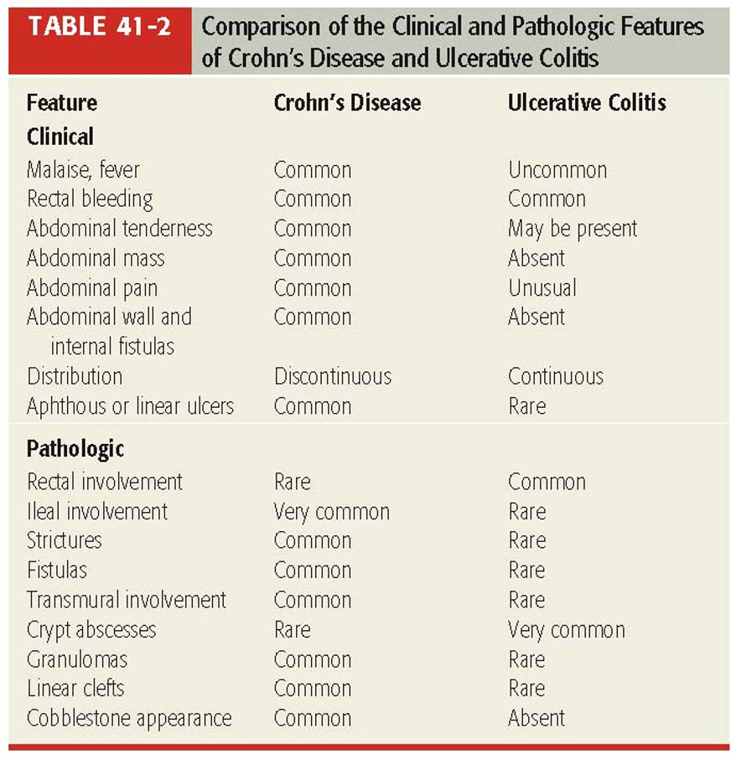
Pathological: UC vs Crohns

Slide 4
Colitis
Classification
Tx based on Classification

Slide 5
Ulcerative Colitis (UC) Classification
Classify for Tx:
<------- 4 -------- 6 ---------10 ----------->
Mild Mod Severe Fulminant
Classification | Stools/day | Systemic Toxicities | Labs
Mild | < 4 (+/- blood) | None | Normal erythrocyte sedimentation rate (ESR) of 0-20 mm/h
Moderate | > 4 (+/- blood) | Minimal | Normal or mildly elevated ESR
Severe | > 6 (bloody) | Fever, tachycardia, anemia | ESR > 30 mm/h
Fulminant | > 10 (continuously bloody) | As above, with abdominal tenderness, transfusion needs, colonic dilation on abdominal film | ESR > 30 mm/h Kornbluth A et al. Am J Gastrol 2010; 105:500.
Notes:
erythrocyte (RBC) sedimentation rate
Fulminant; coming on suddenly and with great severity

Slide 6
Colitis Tx
IV cyclosporine
IV Hydrocortisone
6-MP or Infliximab
Prednisone 50 mg PO. Taper
Sulfasalazine or Mesalamine
Low dose Sulfasalazine or Low dose Mesalamine
Notes:
6-MP = 6 mercaptopurine

Slide 7
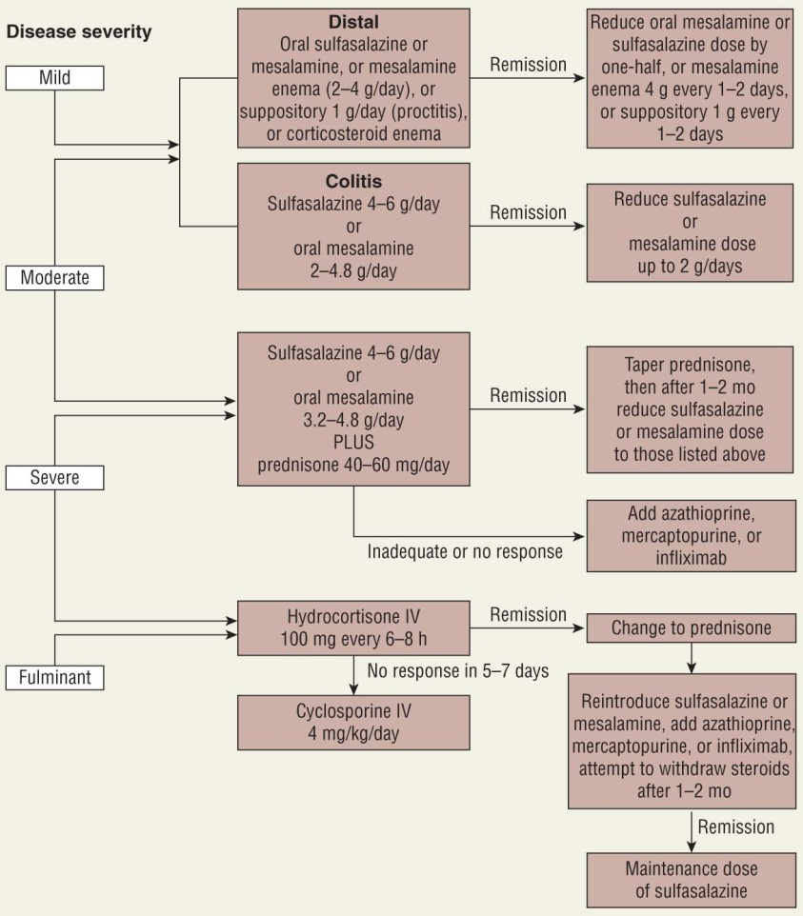
Ulcerative Colitis Tx:

Slide 8
Crohn’s
Classification
Tx based on Classification

Slide 9
Crohn's Classification
Classification | Findings
Mild to Moderate | Patients are ambulatory; able to tolerate oral feeds
Moderate to Severe | Presence of fever, pain, N/V, weight loss, anemia Failed treatment of of mild/moderate disease
Severe to Fulminant | Persistent symptoms despite treatment with induction agents Severe toxicity: high fevers, persistent vomiting, obstruction, cachexia, abscess development

Slide 10
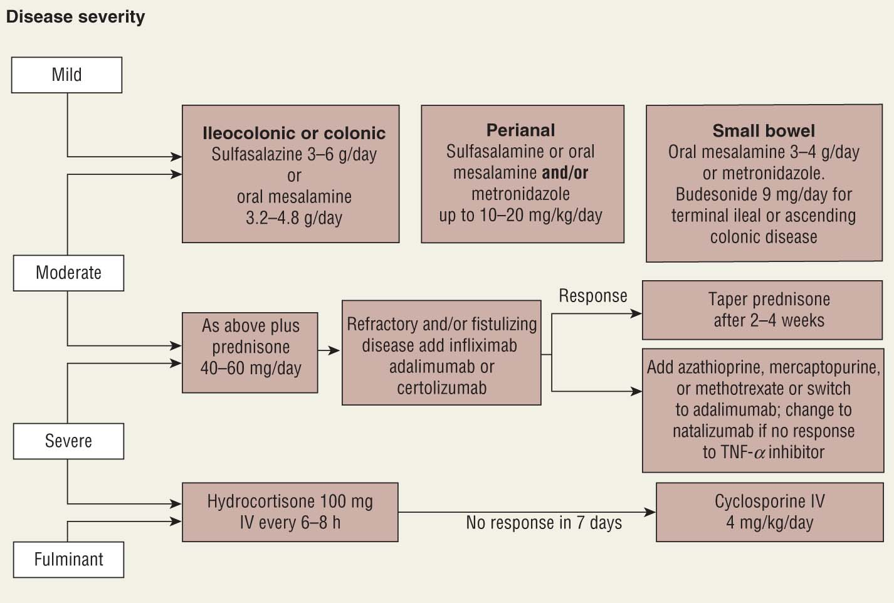
Crohn’s Disease Tx:
Notes:
Small intestine = small bowel

Slide 11
Long-Term Management of IBD: A Summary
Variable | Rectal/Distal UC | Extensive UC | Crohn’s Disease
Mild Disease | PO/PR 5-ASA derivatives PR corticosteroid | PO 5-ASA derivatives | PO 5-ASA derivatives Budesonide
Moderate Disease | PO/PR 5-ASA derivatives PR corticosteroid | PO 5-ASA derivatives | PO corticosteroids AZA or 6-MP
Severe Disease | PO/IV/PR corticosteroids | PO/IV corticosteroids ??? Cyclosporine | PO/IV corticosteroids MTX or IV Infliximab
Refractory Disease | PO corticosteroids + AZA or 6-MP | PO corticosteroids + AZA or 6-MP Infliximab | IV Infliximab MTX
Perianal or Fistulizing Disease | --- | --- | Metronidazole +/- Ciprofloxacin IV Infliximab AZA or 6-MP
Remission | PO/PR 5-ASA derivatives AZA or 6-MP | PO/PR 5-ASA derivatives AZA or 6-MP Infliximab | PO 5-ASA derivatives AZA or 6-MP Infliximab

Slide 12
Drugs for IBD
Aminosalicylate
Corticosteroids
Immunosuppressants
Anti-TNF alpha inhibitors

Slide 13
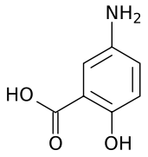
Aminosalicylates
Colitis Tx | Use in Induction and Remission
Crohn’s Tx | Effective in mild disease
Class | 5-Aminosalicyclic Acid Derivatives
MOA | Block COX and Lipoxygenase Similar to ASA
Monitor | Hematologic, Liver, Kidney
Mesalamine
(5-aminosalicylic acid)
Generic | Brand | Dose | Tx Site | Unique
Mesalamine | Pentasa | 2-4g Div QID | Small intestine & Colon | Micro granules that allows slow release
 | Asacol | 2.4 – 4.8g Div QID | Colon & Rectal | Dissolves in pH > 6 small bowl & colon area
 | Lialda | 1.2 – 4.8g daily | Colon | Multi-matrix (MMX) = pH dependent
 | Apriso | 1.5 g daily | Colon | Do not administer with antacids
Sulfasalazine | Azulfidine | 4-6g Div QID | Colon | Prodrug, Possible Sulfa Allergy Possible ASA allergy
Olsalazine | Dipentum | 1.5 – 3g Div BID | Colon | Prodrug: bacteria cleaves bond
Balsalazide | Colazal | 6.75g Div TID | Colon | Prodrug: bacteria cleaves bond
Notes:
If Rectal or Distal, use Suppository or enema

Slide 14
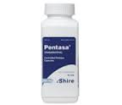
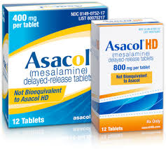
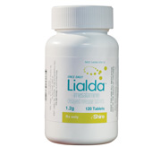
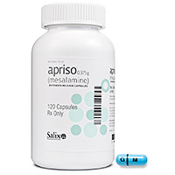
Aminosalicylates

Slide 15
Corticosteroids
Colitis and Crohn’s Tx | Moderate to severe disease for acute inflammation (not chronic)
MOA | Immune suppression/ anti-inflammatory
Onset of benefit | 1 week
Monitor | BG, BP, fluid retention
Generic | Brand | Dose | Pros | Cons
Prednisone Prednisolone | --- | 40 – 60 mg PO daily | Short Term | Taper down 5 mg/week
Budesonide | Entocort | 9 mg PO daily | Longer Term Poorly absorbed in GI Good b/c local action | Only effective in: Distal ileal Right colon
HC enema | Cort-enema | 100 mg HS Enema | 2nd line to 5-ASA w/ Distal colitis | taper
HC suppository | Proctocort | 30 mg BID suppository | 2nd line to 5-ASA w/ Distal colitis | taper
Methylprednisolone Hydrocortisone | --- | IV | NPO | Hospital only

Slide 16
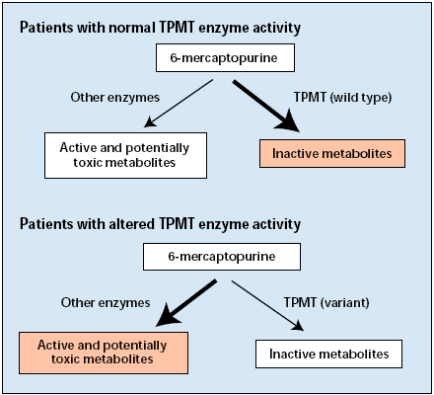
Immunosuppressants
Colitis and Crohn’s Tx | Maintain remission “steroid sparing”
MOA | T cell suppression Purine antagonist
Onset of benefit | Weeks to 6 months
Monitor | Genetic test: TPMT Bone marrow suppression: CBC weekly then 2x/month then Monthly
TPMT: Thiopurine S-methyltransferase
Generic | Dose | Unique
Mercaptopurine (6-MP) | 1 – 1.5 mg/kg/day
Azathioprine | 2 – 2.5 mg/kg/day | Active metabolite of mercaptopurine
Methotrexate | 15-25 mg IM/SQ weekly | Crohn’s disease only. NOT UC Use if intolerant to AZA or 6-MP
Cyclosporine | PO 5-6 mg/kg/day | Salvage therapy in UC Used in pts facing colectomy

Slide 17
Anti-TNFα
Colitis Tx | Moderate to Severe UC refractory to 5-ASA and corticosteroids: Infliximab and Adalimumab
Crohn’s Tx | Moderate to severe CD refractory to 5-ASA, corticosteroids, immunomodulators
MOA | Monoclonal antibody that binds TNF-α inhibiting inflammatory effects in the GIT
Onset of benefit | Days
Prevent Infusion reactions | prevent by giving corticosteroids + antihistamines
Tx infusion reactions | Slow/stop infusion + Antihistamines + APAP
Monitor | Serum-sickness (delayed infused reaction) TB/HepB screening REQUIRED before start of therapy Monitor infection and Lymphoma
Generic | Brand | Dose | Unique
Infliximab | Remicade | Start: 5mg/kg @ weeks 0, 2 and 6 Maintenance: 5mg/kg q 8 weeks | First line for Anti-TNFα For UC only
Adalimumab | Humira |  | For UC only Also for RA
Natalizumab | Tysabri |  | Also for MS
Certolizumab | Cimzia |  | Also for RA

